Slide 1

DEEP REINFORCEMENT LEARNING
Temporal Difference Learning
Raja vadhana Prabhakar
Assistant Professor - CSIS
DRL Team
BITS Pilani WILP

Slide 2
The instructors is gratefully acknowledging the authors who made their course materials freely available online.
This deck is designed by BITS WILP faculty team of course Deep Reinforcement Learning
Deep Reinforcement Learning

Slide 3




Table of Contents
MDP
DP
MC
TD
1
2
3
4
Deep Reinforcement Learning

Slide 4
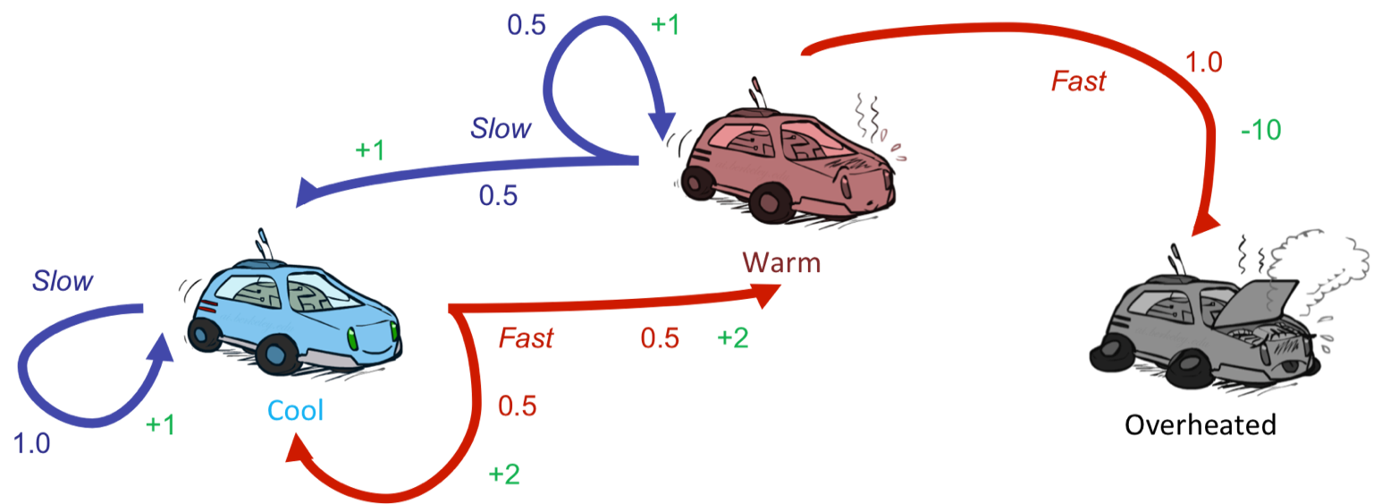
Problem Definition
Race Car Laps
A race car completes laps while managing engine temperature and speed decisions. Here each step is a segment of a lap in the track where the car learns to trades off lap time against overheating risk. The more the lap the car completes it performance betters. Car shuts down only when its engine get overheated (optional terminal state).
Key Characteristics:
The agent must act under uncertainty —
percepts are local, and the agent must reason about hidden dangers
Assume there is no fuel constraints or No.of.Laps to complete!
At every time step the next potential engine temperature
depends on the current engine state not the past history
Deep Reinforcement Learning

Slide 5
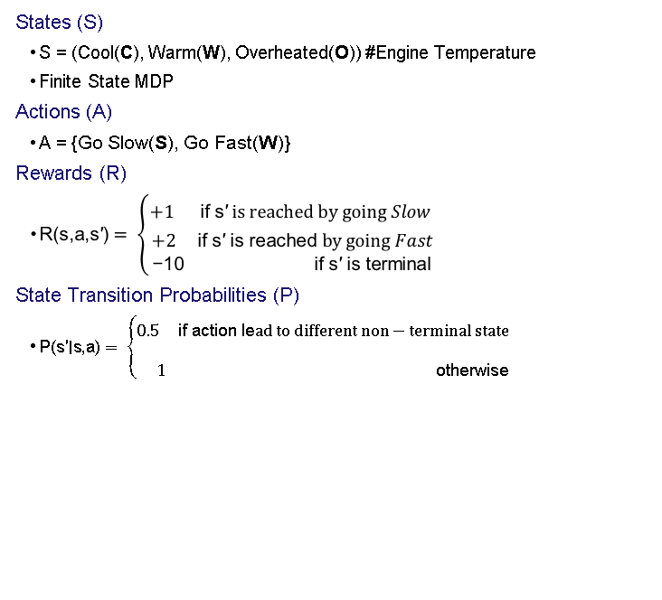
MARKOV DECISION PROCESS FORMALIZATION (Simplified)
1
2
(F) }
3
4
Deep Reinforcement Learning
5
6
7

Slide 6


Table of Contents
MDP
DP
MC
TD
1
2
3
4
Deep Reinforcement Learning

Slide 7
Dynamic Programming
Scenario
In a modified Race car, there is a training track where agent is given a known map and risk factors(dynamics) in advance. Agent knows exactly where it is and its action how actions result in engine state change (KNOWN MODEL).
With full knowledge, the agent can compute optimal policies by trying through all states.
(1)
Deep Reinforcement Learning

Slide 8
Dynamic Programming
1
Given
P(s` | s, a) , R(s, a, s`) , P(s`, r | s, a)
2
To find
Policy π
3
Solution
Policy Iteration (PI): Prefer this in a relatively smaller state space where intermediate termination provides explicit interpretable policy
Value Iteration (VI): Prefer this in a relatively larger state space where fast convergence to optimal policy is obtained at the end
VI can be thought of truncated PI where evaluation is done fully before improvement.
4
Idea
PI : One Step Look ahead 🡪 Evaluate 🡪 Improve
VI : One Step Look ahead 🡪 Control
Deep Reinforcement Learning

Slide 9

Table of Contents
MDP
DP
MC
TD
1
2
3
4
Deep Reinforcement Learning

Slide 10
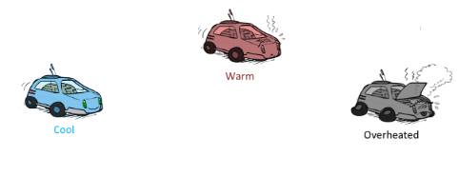
Problem Definition
Race Car Laps
In a modified Race car, there is a training track where agent is given a known (sometimes incomplete) map and risk factors(dynamics) may not be known in advance. Agent knows exactly where it is but its actions impact on the engine state change is difficult to predict (UNKNOWN MODEL).
With partial knowledge, the agent can compute optimal policies by trying through random experiments (Sampling). Car shuts down when its engine get overheated (optional terminal state) or Car stops once the predefined no.of.laps are completed.
Key Characteristics:
The agent must act under uncertainty —
percepts are local, and the agent must reason about hidden dangers
Assume there are fuel constraints or/and No.of.Laps to complete!
At every time step there is no way clear indication of
Impact of next potential engine temperature depending on the
current engine state. The entire past changes might lead to any
possible state change. Hence immediate reward is not always available.
Deep Reinforcement Learning

Slide 11
MARKOV DECISION PROCESS FORMALIZATION (Reduced)
States (S)
S = (Cool(C), Warm(W), Overheated(O)) #Engine Temperature
Finite State MDP
Actions (A)
A = {Go Slow(S), Go Fast(F)}
Rewards (R) and/or State Transition Probabilities (P)
may be non-stationary
Policy still needs estimation of V(S) , Q(S,A) i.e., MDP components but its is not a necessity that the process is expected to follow a Markov Property!! ☺
1
2
3
4
Deep Reinforcement Learning
5
6
7

Slide 12
Monte Carlo Methods
1
Given
S, A, optionally R(s, a, s`)
2
To find
Policy π
3
Solution
Sample Episodes
Compute estimates of the value by discounted returns
Simple average
Weighted average
Normalized weighted average
4
Idea
On Policy :
Generate Sample/Experience 🡪 Evaluate using Return 🡪 Improve
Off Policy :
Refer to Sample/Experience generated by another reference(behavior) policy 🡪 Evaluate using Return 🡪 Improve
Deep Reinforcement Learning

Slide 13
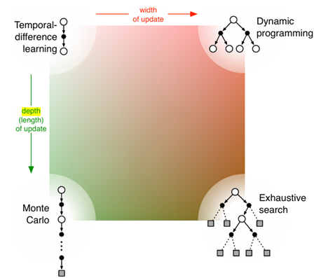
Table of Contents
MDP
DP
MC
TD
1
2
3
4
Deep Reinforcement Learning

Slide 14
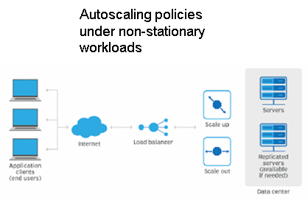
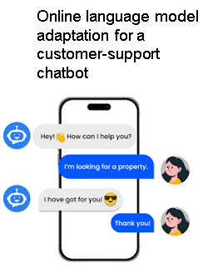
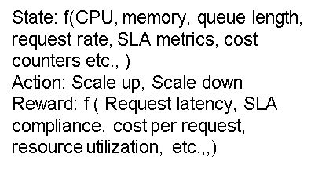
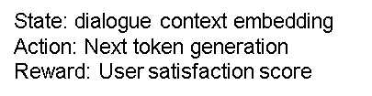
Table of Contents
MDP
DP
MC
TD
1
2
3
4
Deep Reinforcement Learning

Slide 15
Problem Definition
(Modified) Race Car Example
In a modified Race car, there is a training track where agent is given a known (sometimes incomplete) map and risk factors(dynamics) may not be known in advance. Agent knows exactly where it is but its actions impact on the engine state change is difficult to predict (UNKNOWN MODEL).
With partial knowledge, the agent can compute optimal policies by trying through random experiments (Sampling). Car sometimes may shuts down when its engine get overheated (optional terminal state) otherwise Race is allowed to proceed indefinitely (NO predefined no.of.laps to complete)
Key Characteristics:
The agent must act under uncertainty —
percepts are local, and the agent must reason about hidden dangers
Assume there are neither fuel constraints nor No.of.Laps to complete!
At every time step there is an indication (direct/indirect) of
Impact of next potential engine temperature depending on the
current engine state. Immediate reward is available.
Deep Reinforcement Learning

Slide 16
Temporal Difference Learning Methods
1
Given
S, A, R(s, a, s`), (optionally)P(a | s)
2
To find
Policy π
3
Solution
Sample Episodes
Compute estimates of the value by discounted next state estimates (bootstrapping)
Simple average
Weighted average
Normalized weighted average
4
Idea
On Policy :
Generate Sample/Experience 🡪 Evaluate using bootstrapping 🡪 Improve
Off Policy :
Refer to Sample/Experience generated by another reference(behavior) policy 🡪 Evaluate using bootstrapping 🡪 Improve
Deep Reinforcement Learning

Slide 17
Temporal Difference Learning Methods
Policy Evaluation (PE) Algorithm
TD(0)
Next slides follow a full fledged numerical example of algorithm in the Race car example with Policy Evaluation based learning for 2 iterations
Learners are advised to go through the run of the algorithm. This is a full fledged lecture material that was used in NSP2 cluster offering in 2025

Slide 18
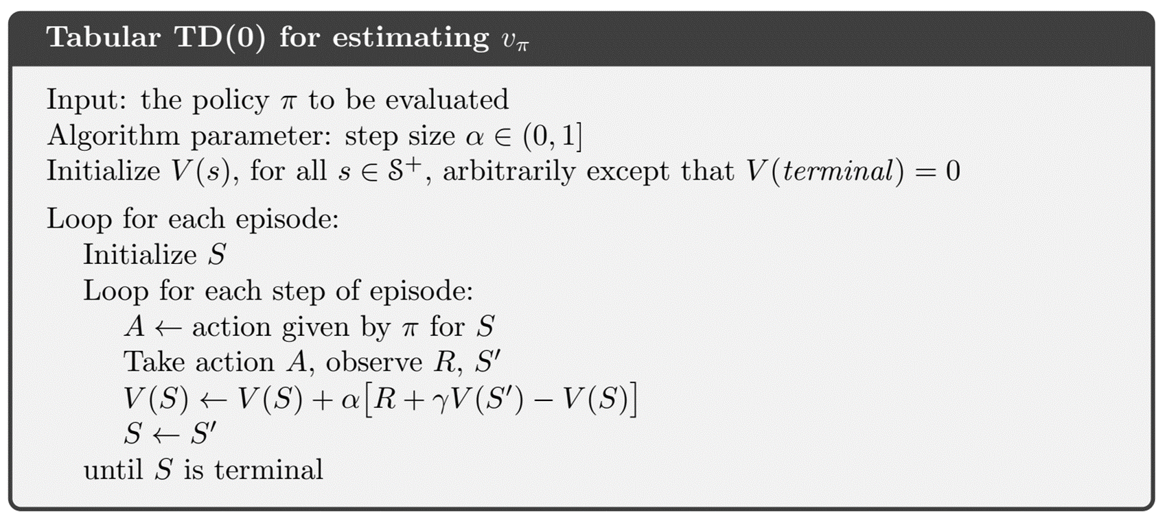

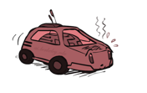
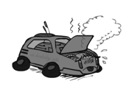
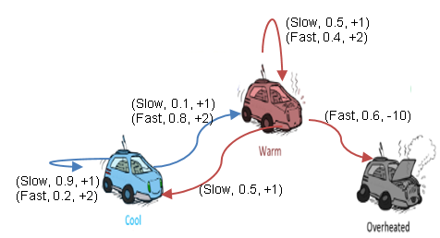
TD(0)
Ꜫ = 0.1
γ = 0.9
α = 0.5
V₀
V₁
V₂
0 0 0
Episode 1: C
Important Note :
In few textbooks/ running incremental upcoming examples, dynamics are given so only to simulate trajectories and show updates step by step. TD itself doesn’t require knowing the full transition model — it only needs sampled transitions (s,a,r,s′) while training from scratch ie., when policy is not known/learnt yet.
The dynamics are provided for clarity and reproducibility, not because TD requires them. In practice, TD works model-free, just like Monte Carlo.
π
Use case : A driving policy is already learnt which needs to be evaluated for monitoring or certification/approval by safety engineers.
Deep Reinforcement Learning

Slide 19
TD(0)
Ꜫ = 0.1
γ = 0.9
α = 0.5
V₀
V₁
V₂
1 0 0
Episode 1: C, F, 2, W
Target = R+ γV(W) = 2+(0.9 * 0) = 2
TD Error = Target – Old Estimate = 2-V(C) = 2-0 = 2
Update the value : V(C) = 0 + 0.5(2) = 1
π
Deep Reinforcement Learning

Slide 20
TD(0)
Ꜫ = 0.1
γ = 0.9
α = 0.5
V₀
V₁
V₂
1 0.95 0
Episode 1: C, F, 2, W, S, 1, C
V(W) = 0 + 0.5 [1+ (0.9*1)-0] = 0.95
π
In practice, we can define an episode cutoff (e.g., after 2 or10 steps or when Overheated occurs). If Overheated isn’t reached, still the episode an be programmed to end artificially. That’s how learning continues.
Deep Reinforcement Learning

Slide 21
TD(0)
Ꜫ = 0.1
γ = 0.9
α = 0.5
V₀
V₁
V₂
1 0.95 0
1.95 2.40 1.40
Episode 1: C, F, 2, W, S, 1, C
Episode 2: C, F, 2, C, F, 2, W, S, 1, W
t=0 : V(C) = 1 + 0.5 [2+ (0.9*1)-1] = 1.95
t=1 : V(C) = 1.95 + 0.5 [2+ (0.9*0.95)-1.95] = ~2.4
t=2 : V(W) = 0.95 + 0.5 [1+ (0.9*0.95)-0.95] = ~1.40
π
Continued for 1 more episode…..
Deep Reinforcement Learning

Slide 22
Temporal Difference Learning Methods
On Policy Control Algorithms
Next slides follow a full fledged numerical example of algorithm in the Race car example with Policy Evaluation based learning for 2 iterations
Learners are advised to go through the run of the algorithm. This is a full fledged lecture material that was used in NSP2 cluster offering in 2025

Slide 23
Temporal Difference Learning Methods
On Policy Control Algorithms
SARSA

Slide 24
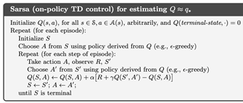


SARSA
Ꜫ = 0.1
γ = 0.9
α = 0.8
Q₀
Q₁
Q₂
0 0 0 0 0 0
Episode 1: C
π
Use case : A driving policy is already learnt but there are few unforeseen changes. Policy needs to be retrained to reflect the actual risk observed via exploration
Deep Reinforcement Learning

Slide 25
SARSA
Ꜫ = 0.1
γ = 0.9
α = 0.8
Q₁
Q₂
Q₃
1.6 0 0 0 0 0
Episode 1: C, F, 2, W, S
Q(C,F) = 0 + 0.8 [2+ (0.9*0)-0] = 1.6
π
From State “C” & “W”, Action “F” & “S” are derived respectively by applying E-greedy on current policy from Q values learnt till now.
In the shown time step : (S,A,R,S,A) = (C,F,2,W,S)
Deep Reinforcement Learning

Slide 26
SARSA
Ꜫ = 0.1
γ = 0.9
α = 0.8
Q₁
Q₂
Q₃
1.6 0 0 1.95 0 0
Episode 1: C, F, 2, W, S, 1, C , F
Q(W,S) = 0 + 0.6 [1+ (0.9*1.6)-0] = ~1.95
π
Terminating episode 1 after 2 steps. In practice, we can define an episode cutoff (e.g., after 2 or10 steps or when Overheated occurs). If Overheated isn’t reached, still the episode an be programmed to end artificially. That’s how learning continues.
Deep Reinforcement Learning

Slide 27
SARSA
Ꜫ = 0.1
γ = 0.9
α = 0.8
Q₁
Q₂
Q₃
1.6 0 0 1.95 0
3.62 0 -8 1.32 0
Episode 1: C, F, 2, W, S, 1, C , F
Episode 2: C, F, 2, C, F, 2, W, S, 1, W , S, 1, W , F, -10, O
t=0 : Q(C,F) = 1.6 + 0.8 [2+ (0.9*1)-1.6] = 3.07
t=1 : Q(C,F) = 3.07 + 0.8 [2+ (0.9*1.95)-3.07] = ~3.62
t=2 : Q(W,S) = 1.95 + 0.8 [1+ (0.9*1.95)-1.95] = ~2.59
t=3 : Q(W,S) = 2.59 + 0.8 [1+ (0.9*0)-2.59] = ~1.32
t=4 : Q(W,F) = 0 + 0.8 [-10+ (0.9*0)-0] = ~-8
π
Deep Reinforcement Learning

Slide 28
SARSA
Ꜫ = 0.1
γ = 0.9
α = 0.8
Q₁
Q₂
Q₃
Q₄
1.6 0 0 1.95 0
Continued for two more episodes….
Observe the difference in value updates w.r.t Q(W,S) between successive time steps in episodes 3 & 4.
At the worst case on larger learning rate eg., 0.8 the pull is even larger
This large pull is an effect of the VARIANCE produced
Solution to tackle : Expected SARSA
3.62 0 -8 1.32 0
3.62 0 6.48 -4.69 0
3.62 0 6.48 +4.47 0
π
Episode 1: C, F, 2, W, S, 1, C , F
Episode 2: C, F, 2, C, F, 2, W, S, 1, W , S, 1, W , F, -10, O
Episode 3: W, S, +1, W, F, +10, O
t=0 : Q(W,S) = 1.32 + 0.8 [1+ (0.9*-8)-1.32] = -4.69
t=1 : Q(W,F) = -8 + 0.8 [10+ (0.9*0)+8] = ~+6.4
Episode 4: W, S, +1, W, F
t=0 : Q(W,S) = -4.69 + 0.8 [1+ (0.9*6.4)+4.69] = ~+4.47
Deep Reinforcement Learning

Slide 29

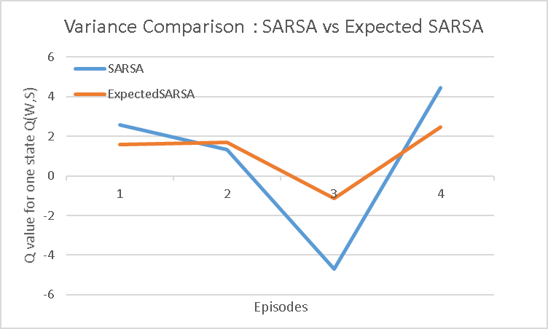
Expected SARSA
Ꜫ = 0.1
γ = 0.9
α = 0.8
Q₁
Q₂
Q₃
Q₄
1.6 0 0 1.37 0 0
2.59 0 -8 1.57 0
2.59 0 6.4 -1.14 0
2.59 0 6.4 +2.46 0
Episode 1: C, F, 2, W, S, 1, C , F
Episode 2: C, F, 2, C, F, 2, W, S, 1, W , S, 1, W , F, -10, O
Episode 3: W, S, +1, W, F, +10, O
t=0 : Q(W,S) = 1.57 + 0.8 [1+ (0.9*((-8*0.5) + (1.57*0.5)))-1.57] = -1.14
t=1 : Q(W,F) = -8 + 0.8 [10+ (0.9*0)+8] = ~+6.4
Episode 4: W, S, +1, W, F
t=0 : Q(W,S) = -1.14 + 0.8 [1+ (0.9*((-1.14*0.5)+(6.4*0.5)))+1.14] = ~+2.46
Continued for one more episode….
Assumed likelihood for all the states “_” for simplicity :P(S|_) = 0.05, P(F|_) = 0.5
Deep Reinforcement Learning
Notes:
-2.484

Slide 30
Temporal Difference Learning Methods
On Policy Control Algorithms
Expected SARSA
Next slides follow a full fledged numerical example of algorithm in the Race car example with Policy Evaluation based learning for 2 iterations
Learners are advised to go through the run of the algorithm. This is a full fledged lecture material that was used in NSP2 cluster offering in 2025

Slide 31
Expected SARSA
Ꜫ = 0.1
γ = 0.9
α = 0.8
Q₀
Q₁
Q₂
0 0 0 0 0 0
Episode 1: C
π
Deep Reinforcement Learning

Slide 32
Expected SARSA
Ꜫ = 0.1
γ = 0.9
α = 0.8
Q₁
Q₂
Q₃
1.6 0 0 0 0 0
Important note from TextBook:
In these results Expected Sarsa was used on-policy, but in general it might use a policy different from the target policy to generate behavior, in which case
it becomes an off-policy algorithm. For example, suppose the target is the greedy policy while behavior is more exploratory; then Expected Sarsa is exactly Q-learning.
Episode 1: C, F, 2, W, S
Q(C,F) = 0 + 0.8 [2+ (0.9*(0.5*Q(W,S)+0.5*Q(W,F))-0] = 1.6
π
Actions “F” & “S` are derived by applying E-greedy on policy from state “C” &“W”, For above highlighted timestep: (S,A,R,S) = (C,F,2,W)
During bootstrapping the expected values are used.
For simplicity in this episode its assumed that all actions are equiprobable for state “W”
Deep Reinforcement Learning

Slide 33
Expected SARSA
Ꜫ = 0.1
γ = 0.9
α = 0.8
Q₁
Q₂
Q₃
1.6 0 0 1.37 0 0
Episode 1: C, F, 2, W, S, 1, C , F
Q(W,S) = 0 + 0.8 [1+ (0.9*(0.5*Q(C,S)+0.5*Q(C,F)))-0] = ~1.37
π
Assumed that all actions are equiprobable from a state in this episode
Deep Reinforcement Learning

Slide 34
Expected SARSA
Ꜫ = 0.1
γ = 0.9
α = 0.8
Q₁
Q₂
Q₃
1.6 0 0 1.37 0 0
2.59 0 -8 1.57 0
Episode 1: C, F, 2, W, S, 1, C , F
Episode 2: C, F, 2, C, F, 2, W, S, 1, W , S, 1, W , F, -10, O
t=0 : Q(C,F) = 1.6+0.8(2+0.9(0.5*1.6+0.5*0)−1.6)=~2.496
t=1 : Q(C,F) = 2.496+0.8(2+0.9(0.5*1.37+0.5*0)−2.496)=~2.59
t=2 : Q(W,S) = 1.37+0.8(1+0.9(0.5*1.37+0.5*0)−1.37)=~1.57
t=3 : Q(W,S) = 1.57 + 0.8 [1+0.9(0.5*1.57+0.5*0)−1.57] = ~1.68
t=4 : Q(W,F) = 0 + 0.8 [-10+ (0.9*0)-0] = ~-8
π
Continued for one more episode….
Assumed likelihood for all the states “_” for simplicity :P(S|_) = 0.05, P(F|_) = 0.5
Deep Reinforcement Learning
Notes:
-2.484

Slide 35
Expected SARSA
Ꜫ = 0.1
γ = 0.9
α = 0.8
Q₁
Q₂
Q₃
Q₄
1.6 0 0 1.37 0 0
2.59 0 -8 1.57 0
2.59 0 6.4 -1.14 0
2.59 0 6.4 +2.46 0
Episode 1: C, F, 2, W, S, 1, C , F
Episode 2: C, F, 2, C, F, 2, W, S, 1, W , S, 1, W , F, -10, O
Episode 3: W, S, +1, W, F, +10, O
t=0 : Q(W,S) = 1.57 + 0.8 [1+ (0.9*((-8*0.5) + (1.57*0.5)))-1.57] = -1.14
t=1 : Q(W,F) = -8 + 0.8 [10+ (0.9*0)+8] = ~+6.4
Episode 4: W, S, +1, W, F
t=0 : Q(W,S) = -1.14 + 0.8 [1+ (0.9*((-1.14*0.5)+(6.4*0.5)))+1.14] = ~+2.46
Continued for one more episode….
Assumed likelihood for all the states “_” for simplicity :P(S|_) = 0.05, P(F|_) = 0.5
Deep Reinforcement Learning
Notes:
-2.484

Slide 36
Temporal Difference Learning Methods
Off Policy Control Algorithms
Q-Learning
Next slides follow a full fledged numerical example of algorithm in the Race car example with Policy Evaluation based learning for 2 iterations
Learners are advised to go through the run of the algorithm. This is a full fledged lecture material that was used in NSP2 cluster offering in 2025

Slide 37
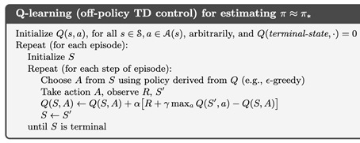
Q-Learning
Ꜫ = 0.1
γ = 0.9
α = 0.8
Q₀
Q₁
Q₂
0 0 0 0 0 0
Episode 1: C
π
Target Policy : Greedy (MAX) is used to evaluate /update the Q values
Behavior Policy : ε-greedy is used to select actions based on the policy derived from Q - Value
Deep Reinforcement Learning

Slide 38
Q-Learning
Ꜫ = 0.1
γ = 0.9
α = 0.8
Q₁
Q₂
Q₃
1.6 0 0 0 0 0
Episode 1: C, F, 2, W, S
Q(C,F) = 0 + 0.8 [2+ (0.9* MAX{Q(W,S),Q(W,F)} )-0] = 1.6
π
Behavior Policy : ε-greedy is used to select actions based on the policy derived from Q - Value . Here action “F” for state “C”
Target Policy : Greedy (MAX) is used to evaluate /update the Q values.
Deep Reinforcement Learning

Slide 39
Q-Learning
Ꜫ = 0.1
γ = 0.9
α = 0.8
Q₁
Q₂
Q₃
1.6 0 0 17.15 0 0
Episode 1: C, F, 2, W, S, 20, C , F
Q(W,S) = 0 + 0.8 [20+ (0.9*(MAX{Q(C,S), Q(C,F)})-0] = ~17.15
π
Terminating episode 1 after 2 steps. In practice, we can define an episode cutoff (e.g., after 2 or10 steps or when Overheated occurs). If Overheated isn’t reached, still the episode an be programmed to end artificially. That’s how learning continues.
Deep Reinforcement Learning

Slide 40
Q-Learning
Ꜫ = 0.1
γ = 0.9
α = 0.8
Q₁
Q₂
Q₃
1.6 0 0 17.15 0 0
16.16 0 -8 11.64 0 0
Episode 1: C, F, 2, W, S, 20, C , F
Episode 2: C, F, 2, C, F, 4, W, S, -5, W , S, 1, W , F, -10, O
t=0 : Q(C,F) = 1.6+0.8(2+0.9(MAX{1.6,0})−1.6)=~3.07
t=1 : Q(C,F) = 3.07+0.8(4+0.9(MAX{0,17.15})−3.07)=~16.16
t=2 : Q(W,S) = 17.15+0.8(-5+0.9(MAX{0,17.15})−17.15)=~11.78
t=3 : Q(W,S) = 11.78 + 0.8 [1+0.9(MAX{0,11.78})−11.78] = ~11.64
t=4 : Q(W,F) = 0 + 0.8 [-10+ (0.9*0)-0] = ~-8
π
Target Policy : Greedy (MAX) is used to evaluate /update the Q values
Behavior Policy : ε-greedy is used to select actions based on the policy derived from Q - Value
Deep Reinforcement Learning

Slide 41
Q-Learning
Ꜫ = 0.1
γ = 0.9
α = 0.8
Q₁
Q₂
Q₃
Q₄
Q₅
Q₆
1.6 0 0 17.15 0 0
16.16 0 -8 11.64 0 0
Observe the difference in value updates w.r.t Q(W,S) between successive time steps in episodes 3 to 6.
The true value is approx. Q(W,S) = 15
Due to MAX bias the values are overestimated and this is more pronounced in the presence of NOISE
Sometimes this diverges from true value.
Solution to tackle : Double Q-Learning
** But in near-deterministic , less noisy environment , Q-learning helps in faster convergence!
16.16 0 6.4 14.71 0 0
16.16 11.39 6.4 22.50 0 0
π
16.16 11.39 6.4 16.70 0 0
16.16 11.39 6.4 19.37 0 0
Episode 1: C, F, 2, W, S, 20, C
Episode 2: C, F, 2, C, F, 4, W, S, -5, W , S, 1, W , F, -10, O
Episode 3: W, S, +5, W, F, +10, O
Episode 4: C, S, +1, W, S, +10, C
Episode 5: W, S, -5, W
Episode 6: W, S, +5, W
Few more episodes are completed and the results of the update per Q(State, Action) is shown . Students are advised to practice this.
Deep Reinforcement Learning

Slide 42
Temporal Difference Learning Methods
Off Policy Control Algorithms
Double Q-Learning
Next slides follow a full fledged numerical example of algorithm in the Race car example with Policy Evaluation based learning for 2 iterations
Learners are advised to go through the run of the algorithm. This is a full fledged lecture material that was used in NSP2 cluster offering in 2025

Slide 43
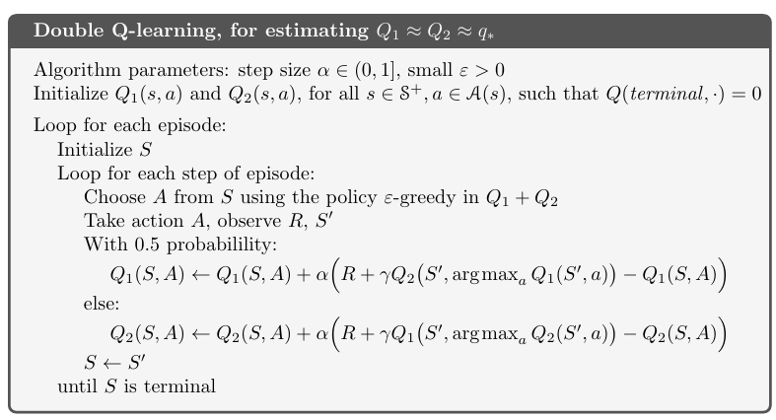
Target Behavior
Ꜫ = 0.1
γ = 0.9
α = 0.8
Q₀
Q₁
Q₂
0 0 0 0
5 1 5 15
Episode 1: C
π
Target Policy : Q2 - Table
Behavior Policy : Q1-Table is available from other sources/experience/logged data. Above algorithm learns to update this as well.
Deep Reinforcement Learning

Slide 44
Target Behavior
Ꜫ = 0.1
γ = 0.9
α = 0.8
Q₁
Q₂
Q₃
5.2 0 0 0
5 1 5 15
Episode 1: C, F, 2, W, S
Q2(C,F)
= 0 + 0.8 [2+ (0.9* Q1(W, ARGMAX{Q2(W,S),Q2(W,F)}) )-0]
= 0 + 0.8 [2+ (0.9* Q1(W, F)-0] #Here both S & F had same values hence randomly “F” is chosen
= 0 + 0.8 [2+ (0.9* 5) - 0]
= 5.2
π
Target Policy : Q2 - Table
Behavior Policy : Q1-Table is available from other sources/experience/logged data. Above algorithm learns to update this as well.
Deep Reinforcement Learning

Slide 45
Target Behavior
Ꜫ = 0.1
γ = 0.9
α = 0.8
Q₁
Q₂
Q₃
5.2 0 0 19.6
5 1 5 15
Episode 1: C, F, 2, W, S, 20, C , F
Q2(W,S) = 0 + 0.8 [20+ (0.9*(Q1(C, ARGMAX{Q2(C,S), Q2(C,F)}) )-0]
= 0 + 0.8 [20+ (0.9*(Q1(C, F) )-0]
= 0 + 0.8 [20+ (0.9*5)-0]
= ~19.6
π
Terminating episode 1 after 2 steps. In practice, we can define an episode cutoff (e.g., after 2 or10 steps or when Overheated occurs). If Overheated isn’t reached, still the episode an be programmed to end artificially. That’s how learning continues.
Deep Reinforcement Learning

Slide 46
Target Behavior
Ꜫ = 0.1
γ = 0.9
α = 0.8
Q₁
Q₂
Q₃
5.2 0 0 19.6
5 1 5 15
6.24 0 -8 13.74
18.3 1 5 15
Episode 1: C, F, 2, W, S, 20, C , F
Episode 2: C, F, 2, C, F, 4, W, S, -5, W , S, 1, W , F, -10, O
t=0 : Q2(C,F) = 5.2+0.8(2+0.9(Q1(C, ARGMAX{Q2(C,F), Q2(C,S)})) −5.2)=~6.24
For step 2 : The loop goes to Q1(S,A) where the behavior policy is updated:
t=1 : Q1(C,F) = 5+0.8(4+0.9(Q2(W, ARGMAX{ Q1(W,S) , Q1(W,F) }) )−5)
= 5+0.8(4+0.9(Q2(W, ARGMAX{ 15, 5}) )−5)
= 5+0.8(4+0.9(Q2(W, S) )−5)
= 5+0.8(4+0.9(19.6 )−5) =~18.3
Only two time step is shown here .
Other time steps updated target policy ie., Q2 table and the
result is tabulated above.
π
Target Policy : Q2 - Table
Behavior Policy : Q1-Table is available from other sources/experience/logged data. Above algorithm learns to update this as well.
Deep Reinforcement Learning

Slide 47
Target Behavior
Ꜫ = 0.1
γ = 0.9
α = 0.8
Q₁
Q₂
Q₃
Q₄
Q₅
Q₆
5.2 0 0 19.6
5 1 5 15
6.24 0 -8 13.74
18.3 1 5 15
Note : Only in Episode 3 step 1 , episode 4 step 2, the loop is simulated to Q1(S,A) loop, where the behavior policy is updated:
6.24 0 9 13.74
18.3 1 5 16.89
6.24 12.9 9 15.71
18.3 1 5 15.87
π
6.24 12.9 9 10.57
18.3 1 5 15.87
6.24 12.9 9 13.7
18.3 1 5 15.87
Episode 1: C, F, 2, W, S, 20, C
Episode 2: C, F, 2, C, F, 4, W, S, -5, W , S, 1, W , F, -10, O
Episode 3: W, S, +5, W, F, +10, O
Episode 4: C, S, +1, W, S, +10, C
Episode 5: W, S, -5, W
Episode 6: W, S, +5, W
Two more episodes are completed and the results of the update per Q(State, Action) is shown . Students are advised to practice this.
Deep Reinforcement Learning

Slide 48
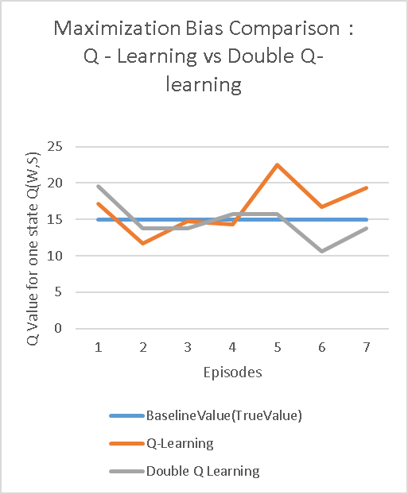
Target Behavior
Ꜫ = 0.1
γ = 0.9
α = 0.8
Q₁
Q₂
Q₃
Q₄
Q₅
Q₆
5.2 0 0 19.6
5 1 5 15
6.24 0 -8 13.74
18.3 1 5 15
6.24 0 9 13.74
18.3 1 5 16.89
6.24 12.9 9 15.71
18.3 1 5 15.87
6.24 12.9 9 10.57
18.3 1 5 15.87
6.24 12.9 9 13.7
18.3 1 5 15.87
Deep Reinforcement Learning

Slide 49
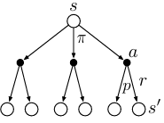



DP TD MC
s
a
s`
a`
.
.
S_{T}
Deep Reinforcement Learning

Slide 50


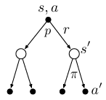
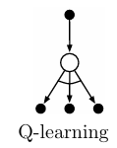
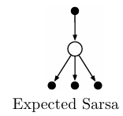


DP TD MC
s,a
s`
a`
.
.
S_{T}
Deep Reinforcement Learning

